Slide 1
Déployer son application PHP
Retour d’expérience CDK

Slide 2
Déployer son application PHP dockerizée
Retour d’expérience CDK

Slide 3
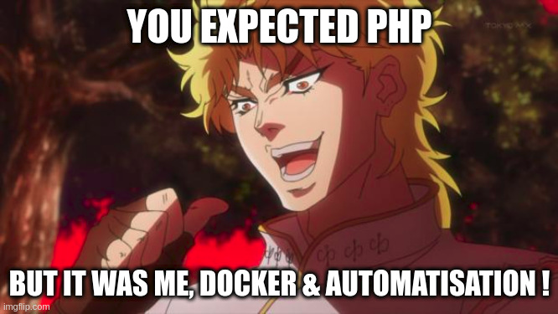
Déployer son application PHP dockerizée, sur AWS.
Retour d’expérience CDK

Slide 4
Intro
Bonjour

Slide 5
Je veux déployer mon application
Step 1: Dockerfile & docker-compose.
Step 2: ???
Step 3: Running containers
Step 4: profit!

Slide 6
Je veux déployer mon application
Step 1: Dockerfile & docker-compose.
Step 2: ???
Step 3: Running containers
Step 4: profit!

Slide 7
Je veux déployer mon application
Step 1: Dockerfile & docker-compose.
Step 2: ???
Step 3: Running containers
=> Serveur privé : EC2
=> Kubernetes : EKS
=> Managé avec petites roulettes : ECS
Step 4: profit!

Slide 8
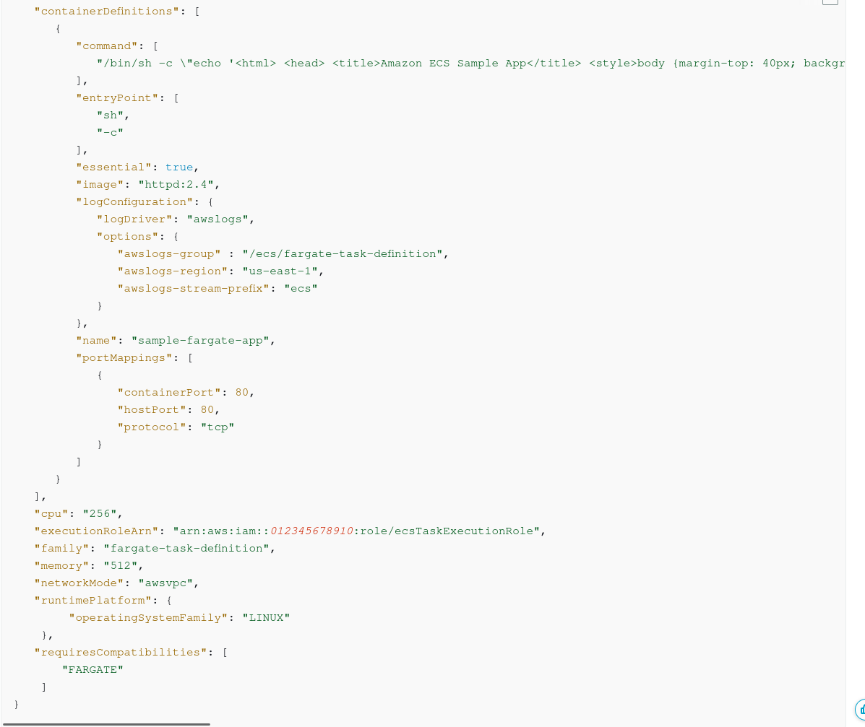
ECS ?

Slide 9
ECS ?
En (très) gros :
docker-compose.yml, version AWS
+ détails des ressources : vCPU, memory, network
+ détails d’AWS : runtime, region, etc.

Slide 10
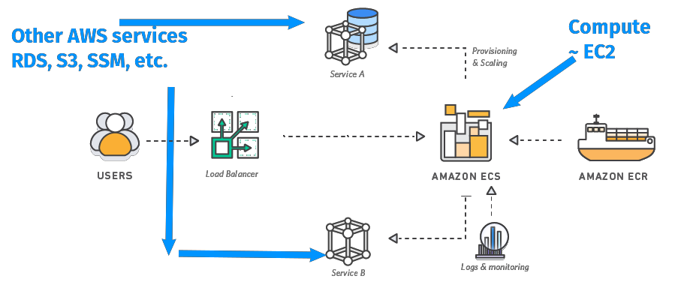

Slide 11
Je veux déployer mon application
Step 1: Dockerfile & docker-compose.
Step 2: ???
Step 3: Running containers
Step 4: profit!

Slide 12
Je veux déployer mon application
Step 1: Dockerfile & docker-compose.
Step 2.1 : Build et push mes images docker
Step 2.2 : Récupérer ces images dockers, et les déployer sur un “server”
Step 3: Running containers
Step 4: profit!

Slide 13
Je veux déployer mon application
Step 1: Dockerfile & docker-compose.
Step 2.1 : Build et push mes images docker = CI (Gitlab)
Step 2.2 : Récupérer ces images dockers,
et les déployer sur un “server” = CDK
Step 3: Running containers
Step 4: profit!

Slide 14
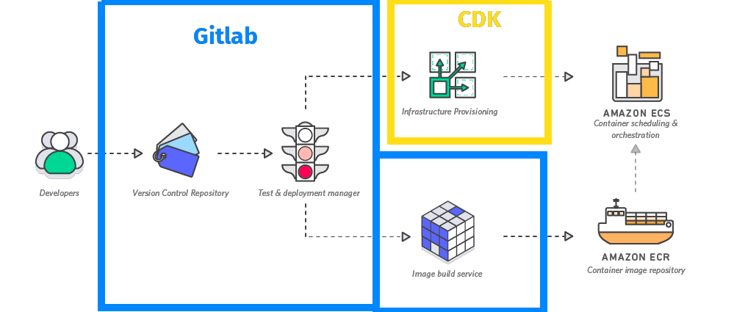

Slide 15
CDK c’est quoi ?
AWS Cloud Development Kit - Juillet 2019
Définissez l'infrastructure cloud à l'aide de langages de programmation courants, TypeScript, JS, Go, Java, C#, Python, PHP (lol)
Autocomplétion dans vos IDE
IAC
…

Slide 16
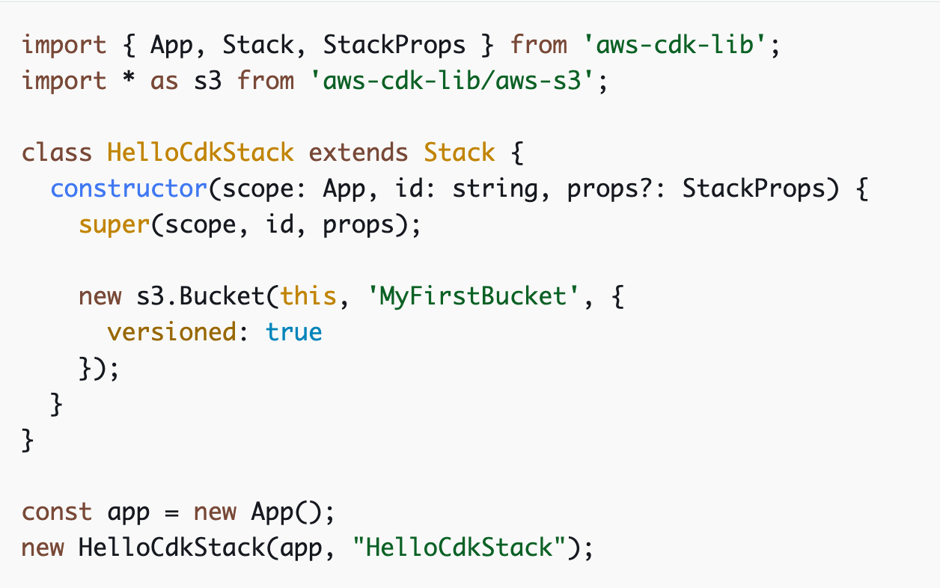
Exemple
Stack
Construct
App

Slide 17
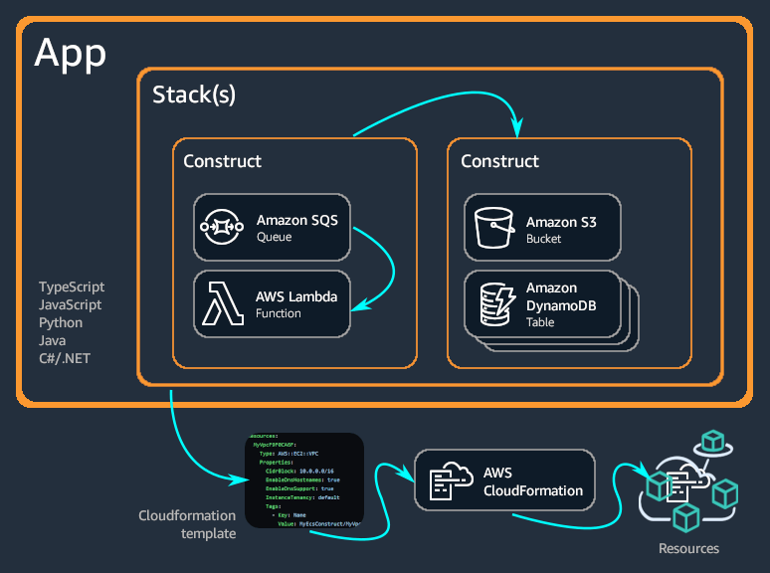

Slide 18
Les bases de CDK
Construct
Stack(s)
App

Slide 19
Les bases de CDK - Constructs
Représente un “composant cloud”
Une ressource simple: s3 bucket
Un ensemble cohérent de ressources: aws-ecs-patterns.ApplicationLoadBalancedFargateService
ECS, ECR, ALB, Route53, ARecord, …
Niveaux de constructs
L1
Mapping direct avec CloudFormation: CfnBucket === AWS::S3::Bucket
L2
Basé sur l’intention: “Je veux un bucket S3”
Pas besoin de connaître en détail la ressource pour la mettre en place
Méthodes et propriétées pour faciliter l’utilisation du construct: bucket.addLifeCycleRule()
L3 / Pattern
Dogmatique, bonnes pratiques AWS
Attention, souvent bonne pratiques === $$$

Slide 20
Les bases de CDK - Stack(s)
L’unité de déploiement de CDK
Équivalent au stacks CloudFormation
Même contraintes

Slide 21
Utilisation
cdk init
cdk list
cdk synth
cdk diff
cdk deploy
cdk destroy

Slide 22
Documentation
https://constructs.dev/
https://docs.aws.amazon.com/cdk/api/v2/

Slide 23
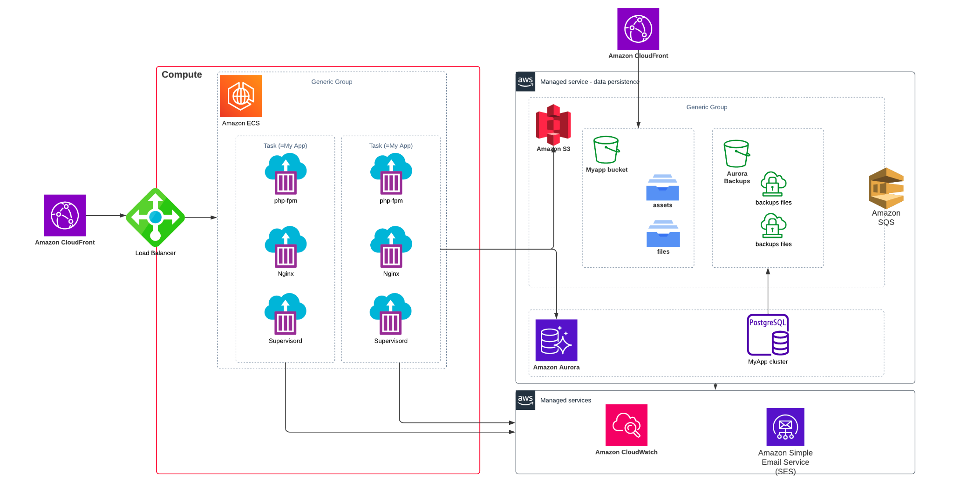
Target
Target

Slide 24
Démo

Slide 25
Bonnes pratiques
Organisation
Code
Constructs
Notes:
For example, if one of your logical units is a website, the constructs that make it up (such as an Amazon S3 bucket, API Gateway, Lambda functions, or Amazon RDS tables) should be composed into a single high-level construct. Then that construct should be instantiated in one or more stacks for deployment.

Slide 26
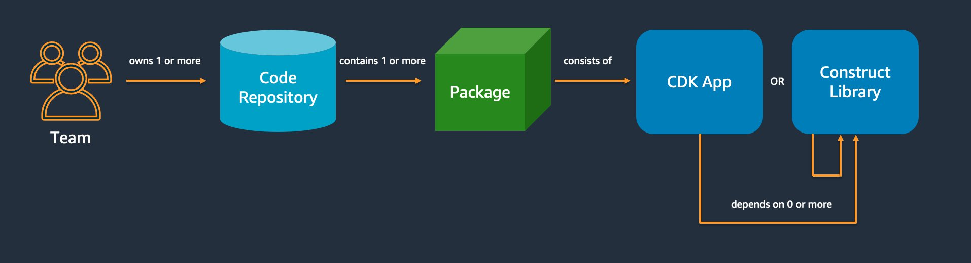
Bonnes pratiques - Code
Notes:
For example, if one of your logical units is a website, the constructs that make it up (such as an Amazon S3 bucket, API Gateway, Lambda functions, or Amazon RDS tables) should be composed into a single high-level construct. Then that construct should be instantiated in one or more stacks for deployment.

Slide 27
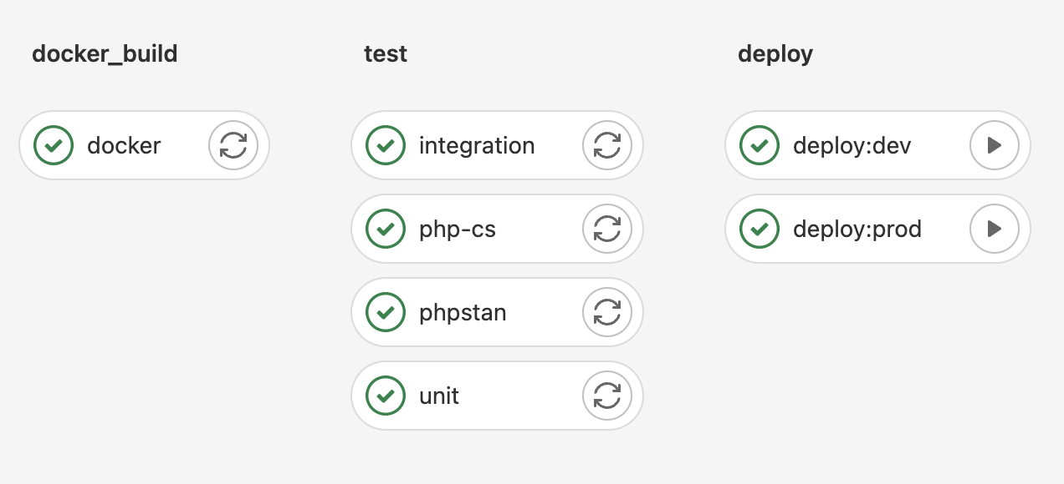
Code - Your CI soon
GitlabCI Pipeline
Build docker image
Push image sur ECR
CDK deploy
Notes:
For example, if one of your logical units is a website, the constructs that make it up (such as an Amazon S3 bucket, API Gateway, Lambda functions, or Amazon RDS tables) should be composed into a single high-level construct. Then that construct should be instantiated in one or more stacks for deployment.

Slide 28
Bonnes pratiques - Constructs
Model with constructs, deploy with stacks
Configure with properties and methods, not environment variables
Unit test your infrastructure
Don't change the logical ID of stateful resources
Use generated resource names, not physical names
Define removal policies and log retention
Separate your application into multiple stacks as dictated by deployment requirements
Let the AWS CDK manage roles and security groups
Notes:
For example, if one of your logical units is a website, the constructs that make it up (such as an Amazon S3 bucket, API Gateway, Lambda functions, or Amazon RDS tables) should be composed into a single high-level construct. Then that construct should be instantiated in one or more stacks for deployment.

Slide 29
Bonnes pratiques - Constructs
Model with constructs, deploy with stacks
Configure with properties and methods, not environment variables
Unit test your infrastructure
Don't change the logical ID of stateful resources
Use generated resource names, not physical names
Define removal policies and log retention
Separate your application into multiple stacks as dictated by deployment requirements
Let the AWS CDK manage roles and security groups
Notes:
For example, if one of your logical units is a website, the constructs that make it up (such as an Amazon S3 bucket, API Gateway, Lambda functions, or Amazon RDS tables) should be composed into a single high-level construct. Then that construct should be instantiated in one or more stacks for deployment.

Slide 30
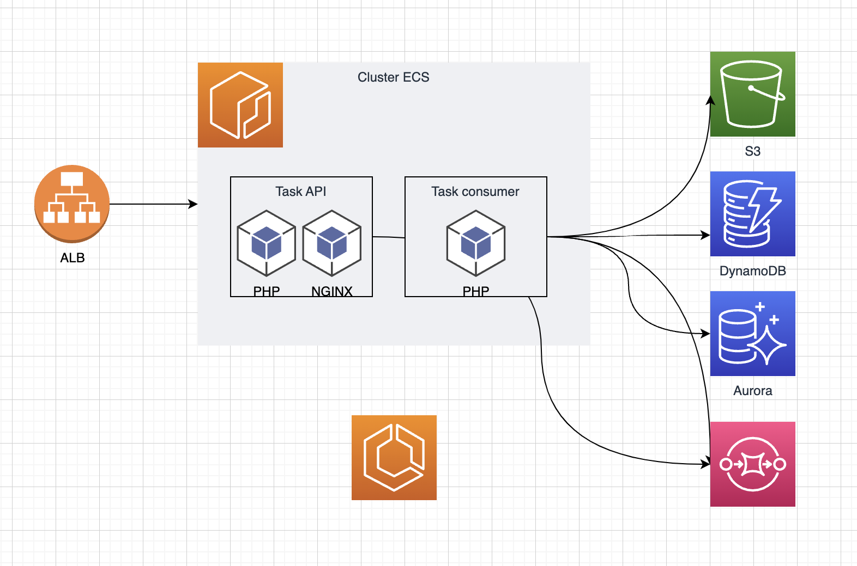
Chez $OLD_JOB
Notes:
For example, if one of your logical units is a website, the constructs that make it up (such as an Amazon S3 bucket, API Gateway, Lambda functions, or Amazon RDS tables) should be composed into a single high-level construct. Then that construct should be instantiated in one or more stacks for deployment.

Slide 31
Chez nous
1 stack par groupe de ressources
database
registry
app
vpc
load-balancer
Configuration des stacks via props
Notes:
For example, if one of your logical units is a website, the constructs that make it up (such as an Amazon S3 bucket, API Gateway, Lambda functions, or Amazon RDS tables) should be composed into a single high-level construct. Then that construct should be instantiated in one or more stacks for deployment.

Slide 32
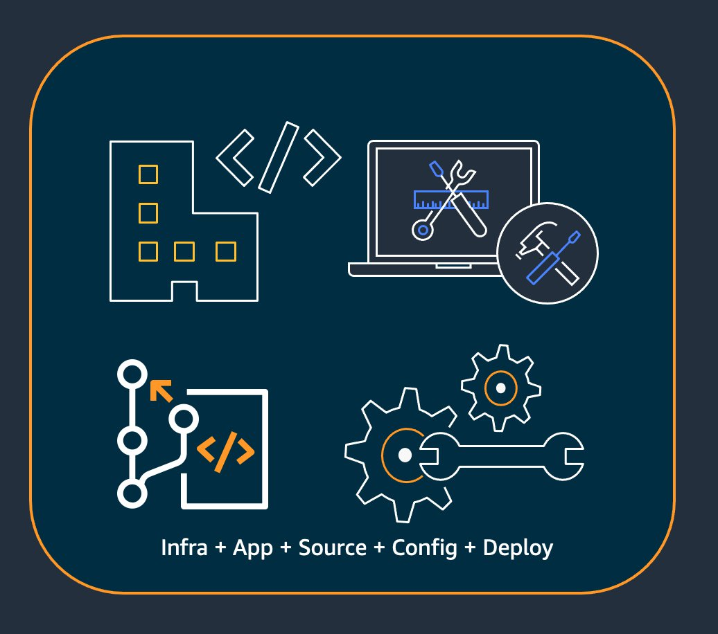
Organisation des constructs
Infrastructure (such as Amazon S3 buckets, Amazon RDS databases, or an Amazon VPC network)
Runtime code (such as AWS Lambda functions)
Configuration code

Slide 33
IAC Composition
Pattern le plus important pour définir des abstraction dans nos constructs
Construire des L3 à partir de L2 et L1
Permet de mettre en place des constructs qui suivent les bonnes pratiques / recommandation de notre équipe
Partager les constructs

Slide 34
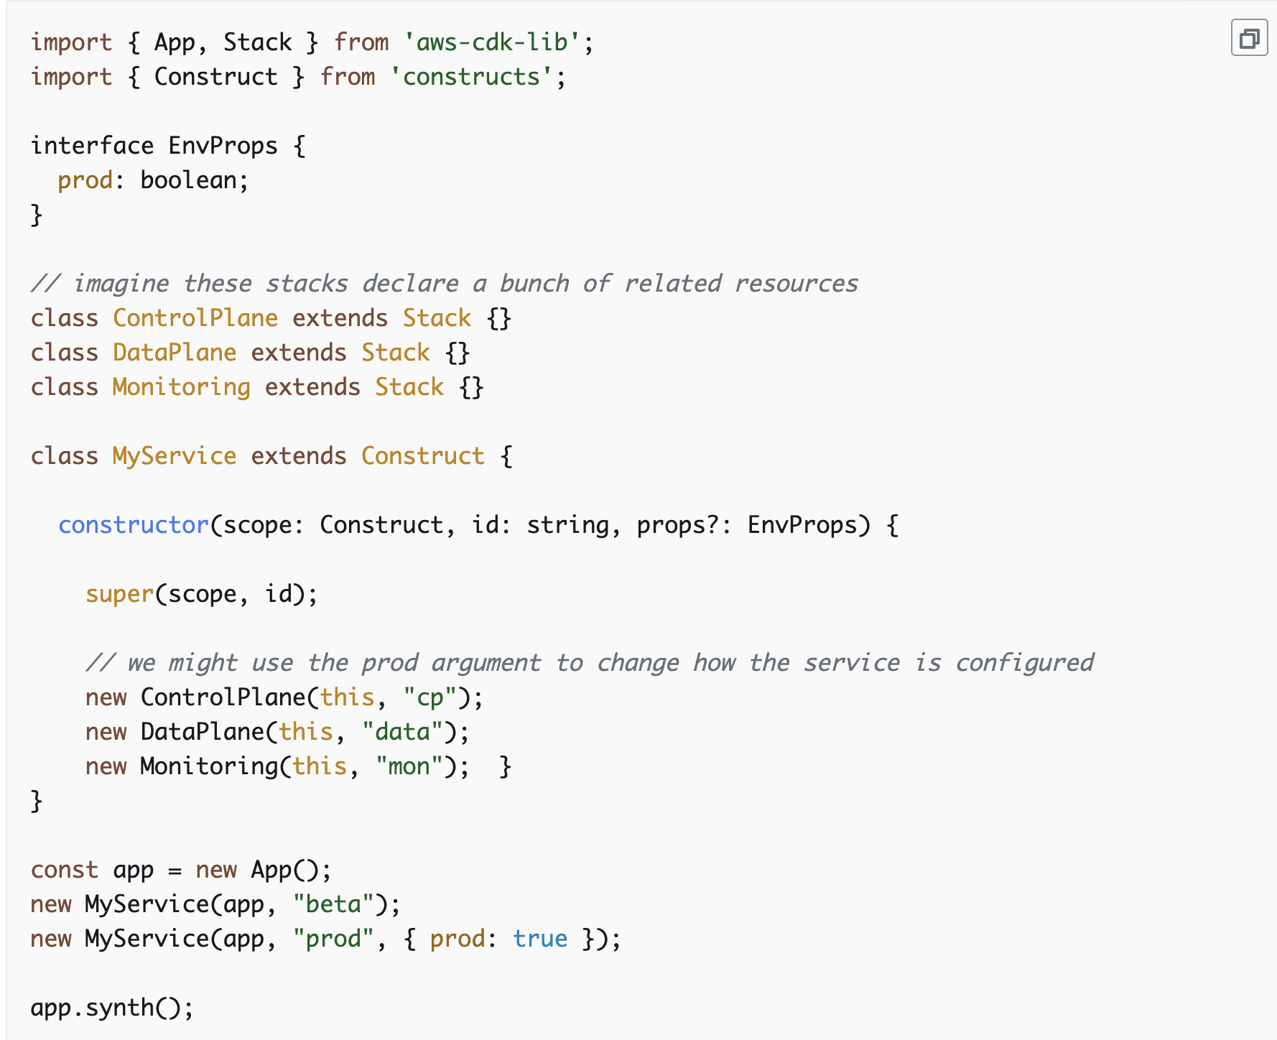

Slide 35
Attention
Déploiement bloqué - ECS
Paramètre par défaut
"requireApproval": "never" cdk.json (CI)
pas si dur de dropper quelque chose
Notes:
For example, if one of your logical units is a website, the constructs that make it up (such as an Amazon S3 bucket, API Gateway, Lambda functions, or Amazon RDS tables) should be composed into a single high-level construct. Then that construct should be instantiated in one or more stacks for deployment.

Slide 36
Questions ?

